Slide 1


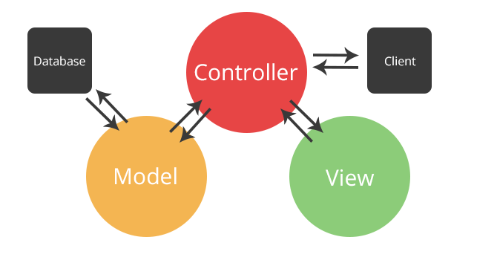

Introduction to MVC
Model-View-Controller
Introduction
to MVC
SoftUni Team
Technical Trainers
Software University
http://softuni.bg

Slide 2
Have a Question?
sli.do #Csharp-Web

Slide 3

MVC
Design pattern with three independent components
Model – manages data and application logic
View – presentation layer
Controller – converts the input into commands and sends them to the view or the model

Slide 4
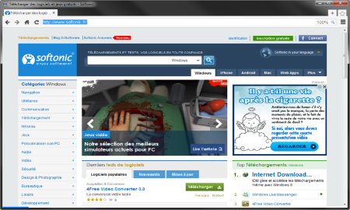



MVC – Control Flow
Web Client
Request
Controller
Response (html, json, xml)
Update Model
User Action
Update View
Notify
Model
View

Slide 5
Overall Architecture
Repository
Service
Controller
Database
View
Entities
Models/ DTO
Backend

Slide 6







Web Development Basics – MVC Framework
https://softuni.bg/courses/csharp-web-development-basics

Slide 7
License
This course (slides, examples, demos, videos, homework, etc.) is licensed under the "Creative Commons Attribution-NonCommercial-ShareAlike 4.0 International" license

Slide 8






Free Trainings @ Software University
Software University Foundation – softuni.org
Software University – High-Quality Education, Profession and Job for Software Developers
softuni.bg
Software University @ Facebook
facebook.com/SoftwareUniversity
Software University @ YouTube
youtube.com/SoftwareUniversity
Software University Forums – forum.softuni.bg

